Slide 1
Science of Science
Virtual
Jul 26 – Aug 6
S⁴
Science of Science Summer School
iSchool, Syracuse University — August 3 / 7, 2020
SOS CD

Slide 2
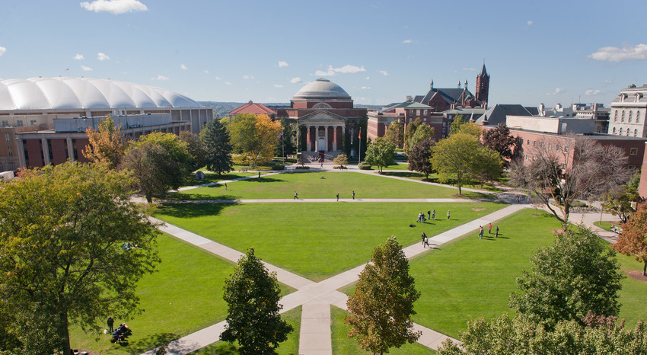
S⁴
Science of Science Summer School
(Virtual) iSchool, Syracuse U— July 26 - August 6, 2021

Slide 3
S⁴
Science of Science Summer School
iSchool, Syracuse University — August 3 / 7, 2020
Sponsored by NSF under #1933803
confirmed speakers and mentors
organizers
Tim Erringston
COS
James Evans
University of Chicago
Vincent Larivière
University of Montreal
Staša Milojević
Indiana University
Daniel Acuña
Syracuse University
Stephen David
Oregon Health & Science University
special invitees
Dashun Wang
Northwestern University
Bruce Weinberg
The Ohio State University
Jevin West
University of Washington
Kevin Crowston
Syracuse University
Bei Yu
Syracuse University
Jian Qin
Syracuse University
When: August 3 – 7, 2020
Apply by: April 6, 2020
Where: iSchool, Syracuse University
https://scienceofscience.org/s4/

Slide 4
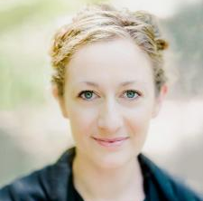
S⁴
Sponsored by NSF
under award #1933803
teachers and mentors
organizers
Tim Errington
COS
James Evans
University of Chicago
Vincent Larivière
University of Montreal
Staša Milojević
Indiana University
Daniel Acuña
Syracuse University
Stephen David
Oregon Health & Science University
invited speakers
Dashun Wang
Northwestern University
Bruce Weinberg
The Ohio State University
Jevin West
University of Washington
Casidy Sugimoto
Indiana
University
Bei Yu
Syracuse University
Jian Qin
Syracuse University
When: August 2 – 6, 2021
Apply by: May 15, 2021
Where: iSchool, Syracuse University
https://scienceofscience.org/s4/

